Slide 1
IABC BC Presentation
Issues Management & Beyond
John Larsen, ABC, MC
President
February 19, 2013

Slide 2
Thanks Granma!
“Hollow drums make most noise”

Slide 3
Quick Roadmap…
Thinking about issues – how can we slice & dice them?
Acting on issues – how can we bringing clarity & your role?
Using imagination – how can you challenge yourself?

Slide 4
Part 1
Thinking About Issues

Slide 5
What Are Issues ALL About?
Values!!

Slide 6
Issues Framed Through Reputation
Reputation in the rear view mirror – the past
Linked to your ‘brand’ – how have you handled issues
Reputation pulling up beside you – the present
Linked to your ‘legitimacy’ – how are you handling issues
Reputation on the highway ahead – the future
Linked to your ‘inspiration’ – how people expect you to handle issues

Slide 7
Character: Money in the Bank
+
Brand Equity
-
Issues Management Cycle
(Value based)
Crisis Management Cycle
(Control based)

Slide 8
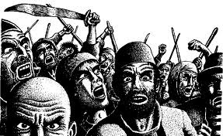
Issue Orientations…
Outside-in orientation
Gap between expectations and actions
Probability of negative consequence
Inside-out orientation
“Can’t get prioritized or coordinated”
“Don’t have the resources for solutions”
How many issues do you have per year?

Slide 9
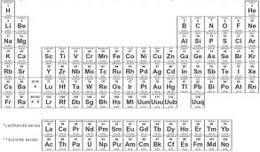
Issues Chemistry…
History
Legitimacy
Culpability
Control
Timeline
Impacts…

Slide 10
The Public Lens of Legitimacy
Ability to hear
(showing you care)
Ability to act
(making a difference)
Ability to learn
(inspiring
Improvement)

Slide 11
Part 2
Acting on Issues

Slide 12
First – Get Ready…
Have your tools
Scanning
Prioritization
Build your team
Comms – corporate to business units
Other – Legal, HR, Environment, etc
Know your processes
Assessment
Reporting

Slide 13
Knowing Your Issue Audiences
A – Advocates
The experts…those with the facts and can speak to your story
B – Base
The general public…the broader coalition that can contextualize
C – Community
The stakeholders…those most directly affected

Slide 14
The Action Checklist
Reputation Attributes
Hearing
Acting
Learning
Audiences
(Care)
(Difference)
(Improve)
Advocates
?
?
?
(Experts)
Base
?
?
?
(Public)
Community
?
?
?
(Stakeholders)

Slide 15
Issue Positioning Strategies
Issue engagement
Issue rejection
Acceptance Strategy | Broadening Strategy
Acknowledge the issue and accept responsibility while addressing way-ahead | Acknowledge the issue but broaden responsibility to other parties
Deflection Strategy | Contention Strategy
Acknowledge the issue but refer it to other authorities; don’t engage in discourse | Fundamentally reject the premise of the question or accusation

Slide 16
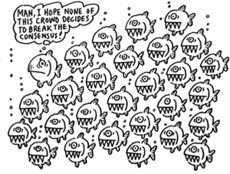
The Issue Response Song-sheet...

Slide 17
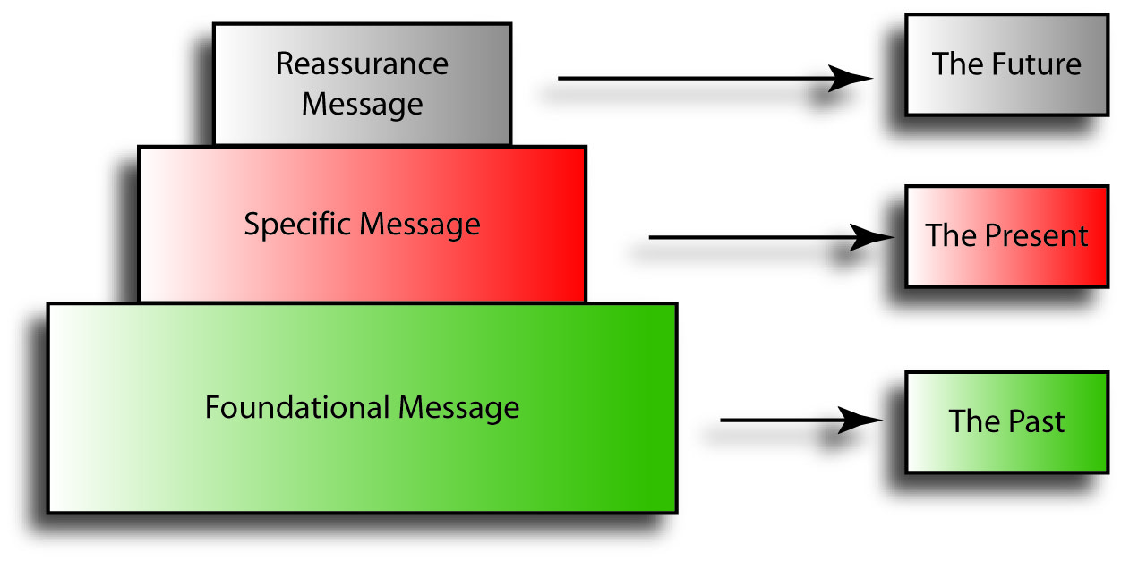
Layer Your Issue Messaging

Slide 18
Quick Tips on Messaging…
Break messages into themes
Use one or two ‘trigger words’
Deliver messages in phases
Don’t overload your audiences
Have strong supporting facts
Aim to contextualize, not minimize

Slide 19
Communications…and Change!
Weigh the issue
Who cares about what?
…………………………………………………………………………………………………….
Effect good strategic communications
Aligning the public to your position
Effect good policy / operations changes
Aligning your actions to the public position

Slide 20
Join the Dominant Coalition…
Serve as the issue ‘manager’
Coordinate non-communicators
Ensure robust reporting
Manage info expectations
Become indispensable
Provide strong executive counsel

Slide 21
Part 3
The Power of Imagination

Slide 22
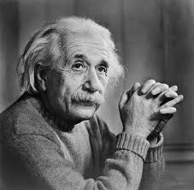
Take it From A Genius!
“Imagination is more important than knowledge”

Slide 23
Issue Management Skills Come Early
Children can engage in imagining, pretend and role-play from an early age. For example, they will start to use one object to represent another from as early as 12 months, sometimes even earlier. Later, their imaginative play becomes more complex and they will begin to take on specific roles. Later still, children will start to involve others in their elaborate imaginative role play.
Around the age of two or three, children begin to think "What if . . .?" or, "What might happen…?" or, "Supposing that happens . . ."
Jacqueline Harding, Educational Director - BBC

Slide 24
Let’s Take a Step Back…
My question to you…
…if we can see possibilities about reciprocal actions and interpretations as children, why does it become so seemingly more more difficult as adults?
“Imagination is more important than knowledge”

Slide 25
Begin Thinking Differently Today!
Ask about the public’s values and expectations
Don’t fixate on the situation itself…use your imagination!
Build a ‘bionic team’
Be part of the dominant coalition…use your imagination!!
Ask “how can we honestly do better”
Don’t allow excuses to become answers…use your imagination!!!

Slide 26
Some Questions for You…
Are you effectively optimizing all of your communication channels to identify issues early in the issue lifecycle?
Monitoring issues external to your organization / issues of longer term impact and from broader sources, etc?
When balancing multiple issues do you have a method to assess the severity of the issue?
And does this link to effective impact assessment, prioritization and action planning?
Once an issue has been deemed as “high” priority, do you have sufficient leverage and enough resources to manage the issue and build messaging?
How do you build yourself into the dominant coalition?

Slide 27
Thank You – Questions?
John Larsen, ABC, MC
403-860-1421
johnlarsen@corpengroup.com
corpengroup.com
@corpengroup

